Slide 1
Springworks Farm Study # 3
Windham Packaging, LLC
Gabriela Hernandez

Slide 2
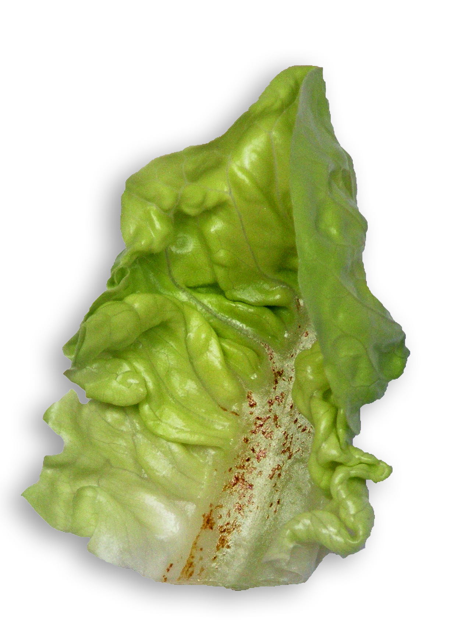
Summary and Conclusions
Baby romaine in OTR3 bags had a shelf life of 14-15 days. OTR3 maintained the quality more effectively than bags used in previous studies, therefore we recommend proceeding with OTR3 bags for baby romaine.
Bottom rot was noticed in the inner leaves of all samples starting on day 6.
Bottom rot symptoms include sunken, reddish/brown lesions on leaf petioles and midribs that touch the soil
Bottom rot is caused by a soilborne fungus that favors warm, moist environments. It can be managed with fungicides combined with cultural control strategies.
Bottom Rot

Slide 3
Results and Discussion:
Internal Temperature and Headspace Analyses
Visual Quality Throughout Shelf Life
Photos
Visual Comparisons and Presence of Defects among Samples
Shelf Life Studies

Slide 4
Temperature and Headspace Levels in Baby Romaine
Days in Storage | Temperature Inside Bag (°F) | Temperature out of bag (°F)
6 | 58.64 | 55.58
9 | 51.98 | 51.8
12 | 52.7 | 51.8
14 | 52.16 | 51.98
16 | 52.52 | 50.36
Temperature was highest on day 6 because it had not yet stabilized since being moved from 50°F to 40-42°F on day 4.
Temperature decreased on day 9 and remained constant throughout the study.
%O2 was highest on day 4, then decreased on day 6. On days 9-16, %O2 remained constant (~11% ± 0.6)
Respiration began to increase on day 6, which could explain the higher temperatures and increased CO2.

Slide 5
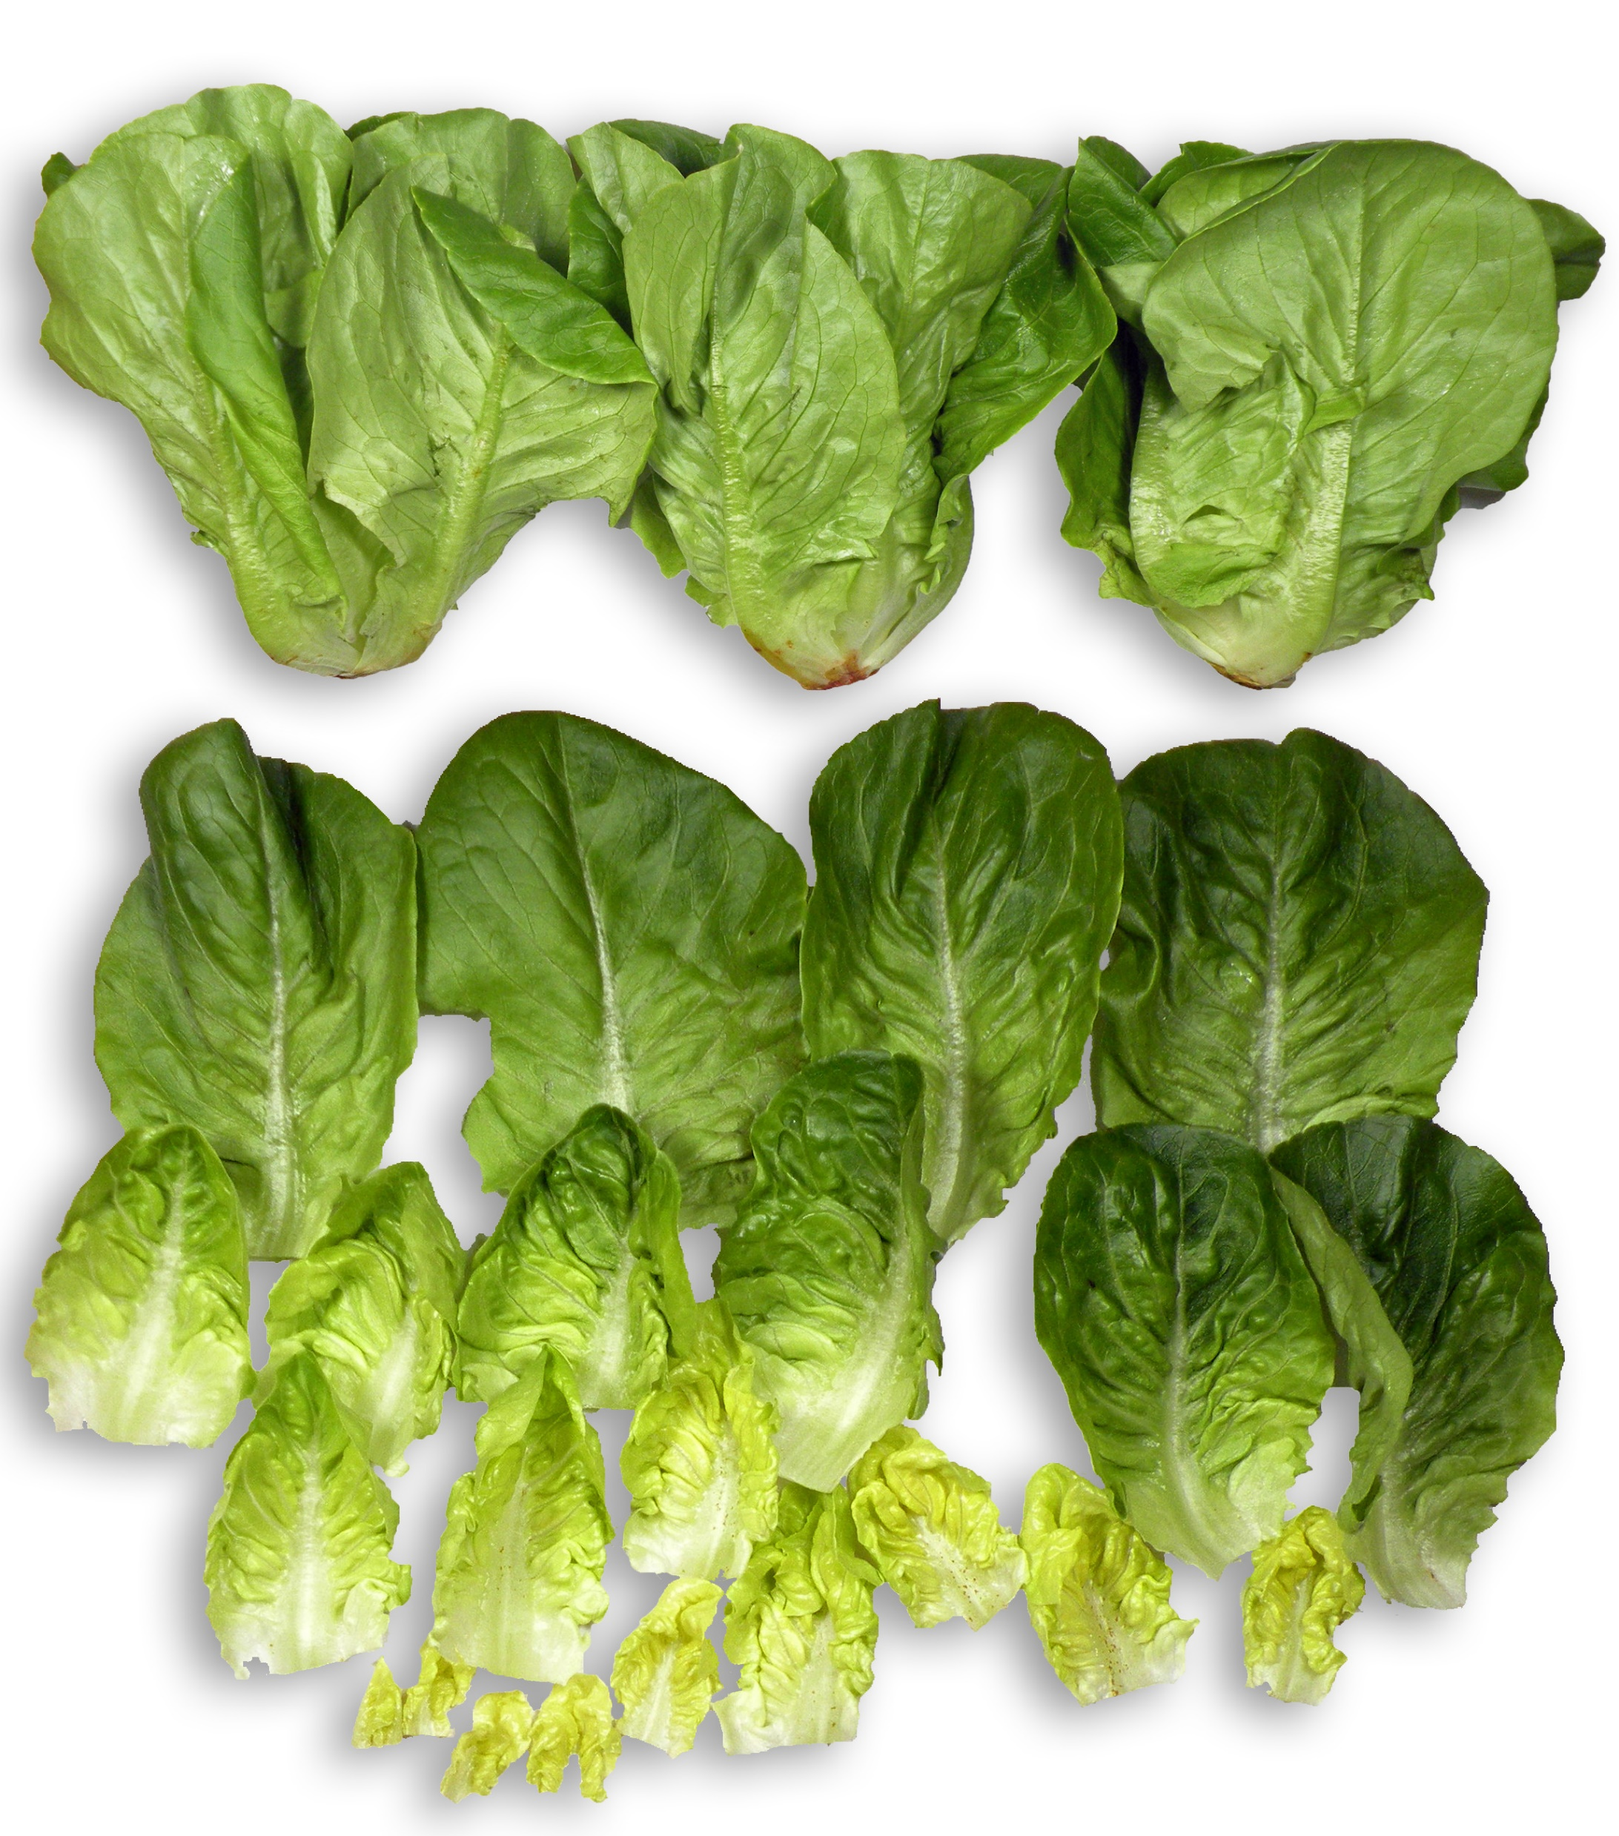
Days 4 & 6
On days 4 and 6 stems were red/brown and there was a small amount of decay noticed near stem.
Day 6
Mildew was present in 1 outer leaf
Bottom rot was present in 5 inner leaves
Taste was good and fresh
Day 6 Baby Romaine

Slide 6
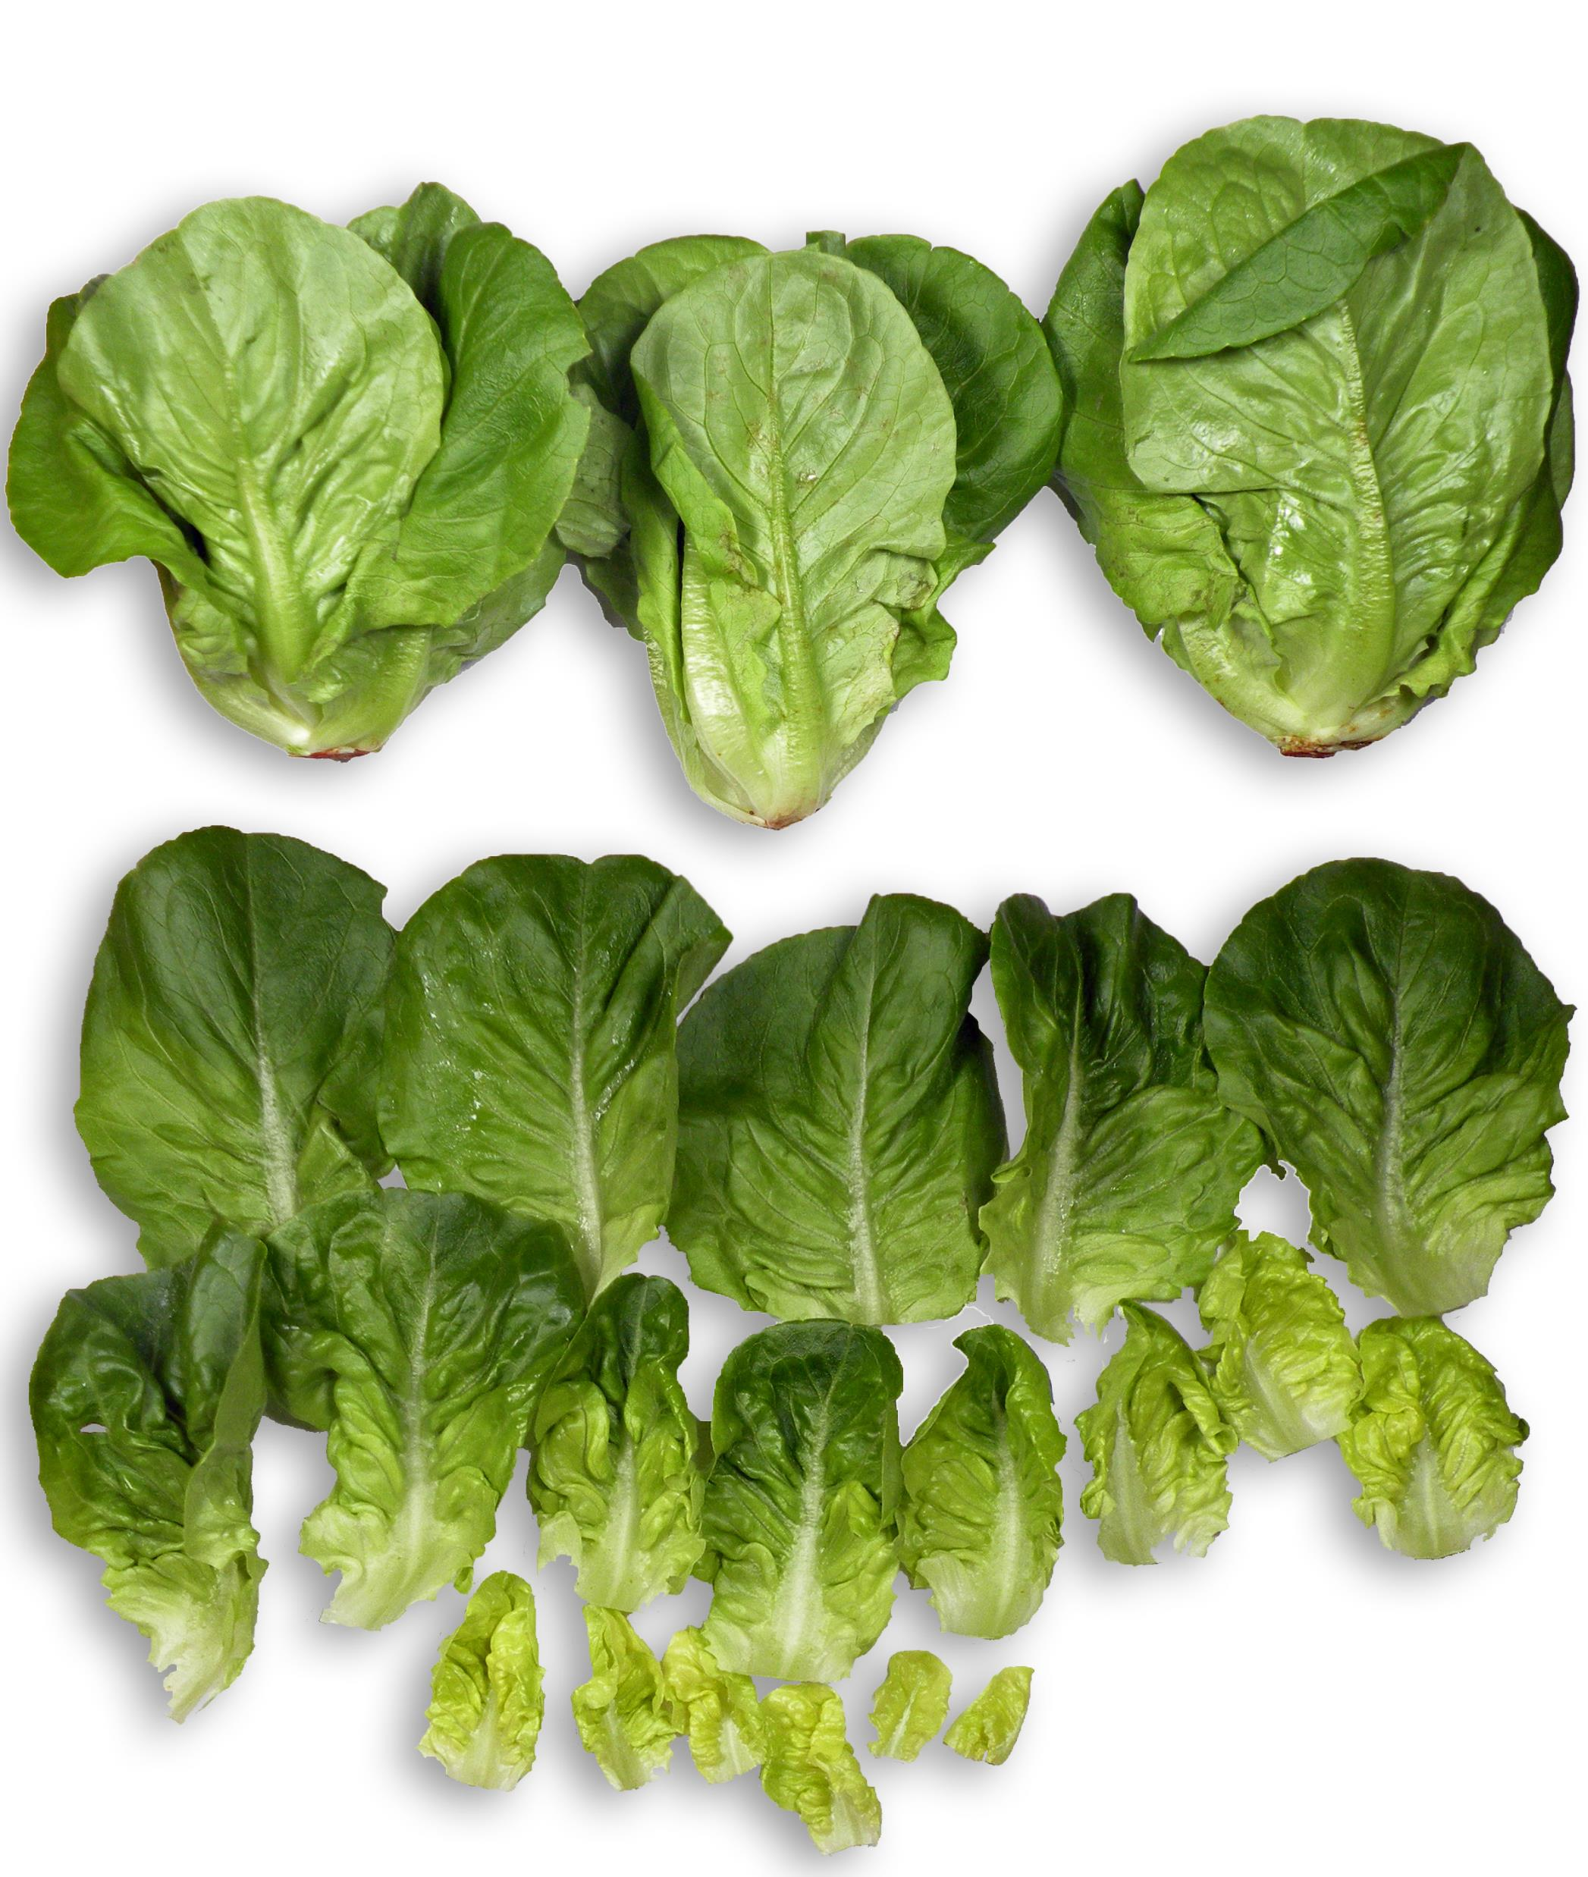
Day 9
Stems were red/brown
1 outer leaf was slightly decayed
Mildew was found in some of the outer leaves
There were some rust spots near the stems
3 inner leaves showed signs of bottom rot (small brown spots)
Taste was good and fresh

Slide 7
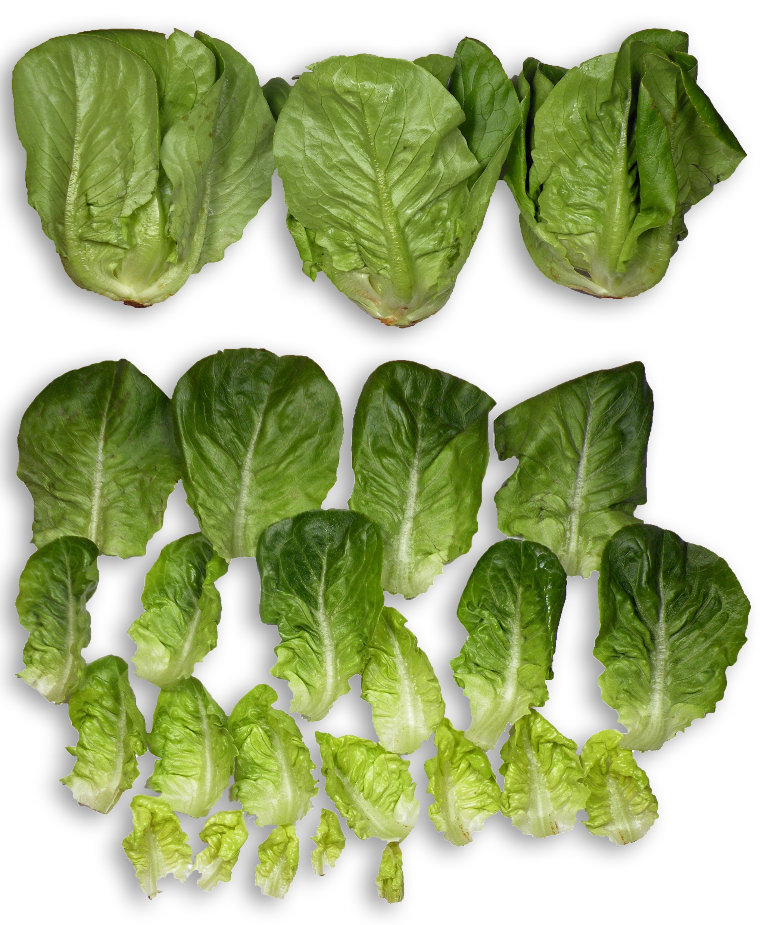
Day 12
Stems were red/brown and started showing signs of decay
3 outer leaves contained mildew
3 outer leaved had rust spots
3 inner leaves had bottom rot
Taste was good and fresh.

Slide 8
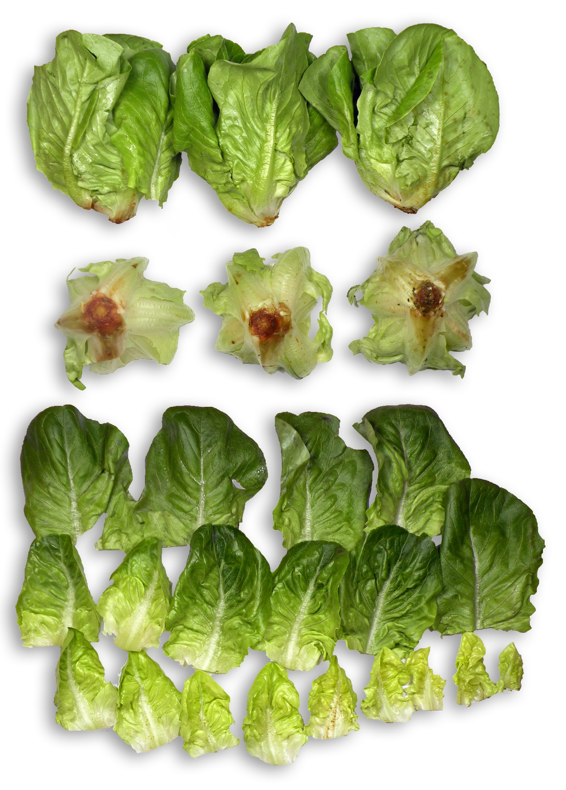
Day 14
Stems were rotting
2 outer leaves were decayed
1 outer leaf had mildew, 2 outer leaves had mold
2 outer leaves had rust spots
6 inner leaves had bottom rot
Taste was good and fresh.

Slide 9
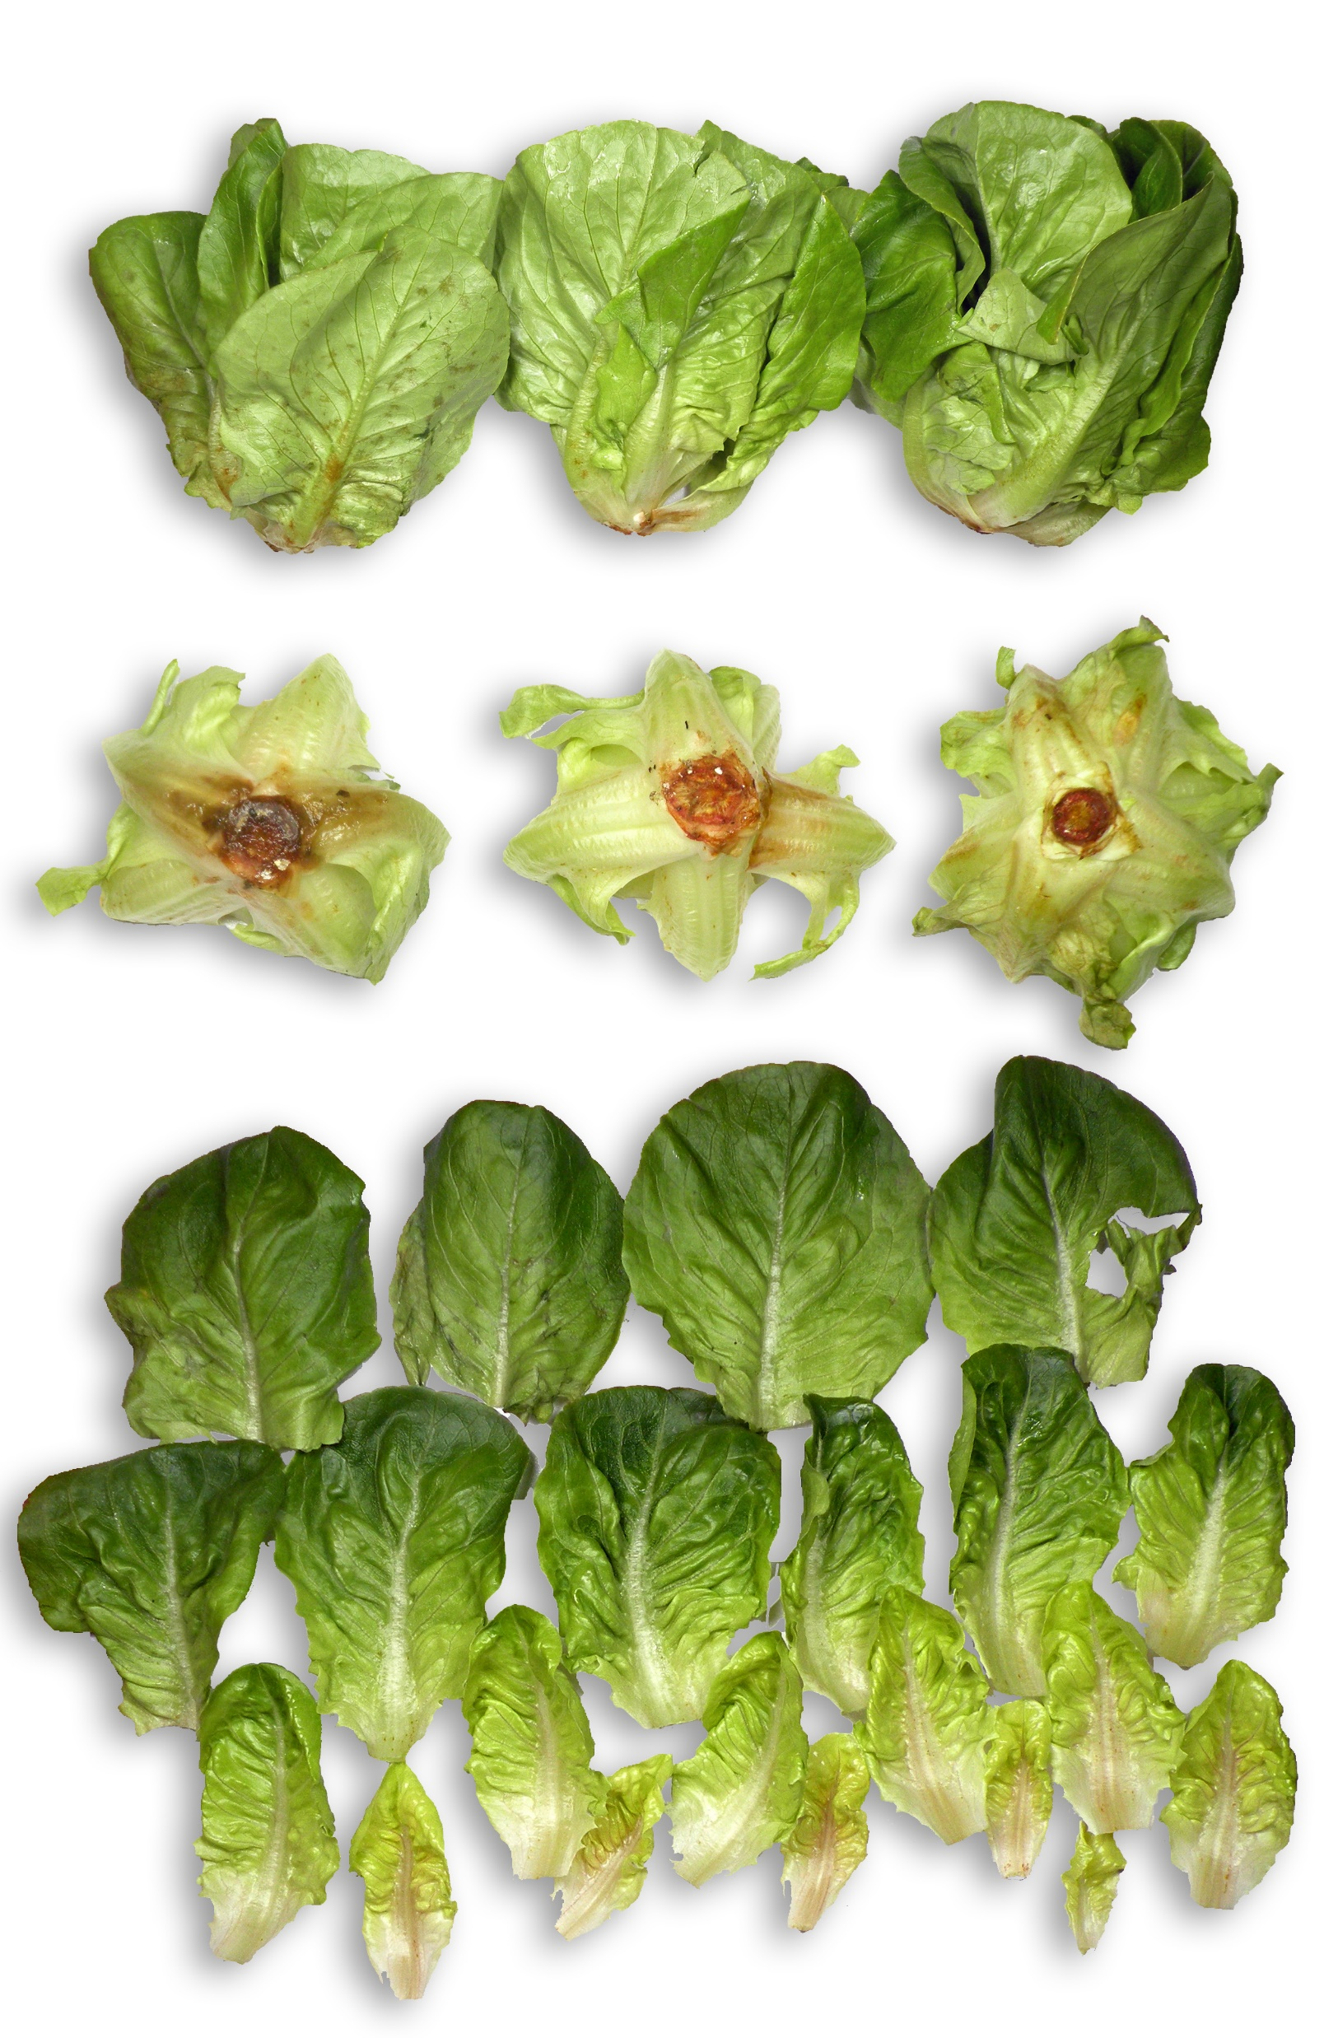
Day 16
Off odor was present upon opening the bag
2 outer leaves were decayed
13 inner leaves had brown spots or the ribs were brown in color
Taste was good.

Slide 10
Materials and Methods
Baby romaine heads were grown and harvested at Springworks Farm at 70°F. The harvested product was moved to a cooler (34-36°F) and cooled for at least 30 minutes.
The harvested product was moved to a cooler (34-36°F). Baby romaine was packaged in Windham Packaging MAP bags (OTR 3). The product was packaged in the cooler and held at 34-36°F for 3 days.
The samples were packaged into vented, cooled cartons and transported to the laboratory at Windham Packaging, Windham, NH.
Packages were stored at 45-50°F for 4 days, then moved to 40-42°F for the remainder of the study.

Slide 11
Procedures: Quality Testing
Quality observations such as decay, yellowing, mold/mildew, mechanical damage, stem color, browning, taste and off-odor were observed. Samples were tested on days 4, 6, 9, 12, 14, and 16.
Temperature of lettuce was checked with an infrared thermometer while the product was both inside and outside of the bags.
Headspace readings inside packages were checked using a gas analyzer
Shelf life studies were done on each sample during each test day. One head of romaine was taken from one test bag per day and every leaf was observed for defect.

